Slide 1
SUPERHERO U FACE-BOOK ADVERT CAMPAIGN ANALYSIS
Data Visualization
SLU DV August 7th Group 13
Faroye Olumide

Slide 2
Project Description
To recommend to the finance team the two worst campaign to discontinue and cut cost with from the marketing team on facebook advert campaign they run for an event called Superhero U from the data provided.

Slide 3
Key Objectives
To compare the average total spent on each campaign
To compare the average of cost and unique clicks of each campaign
To compare the average cost per click for each campaign
To compare the average campaign reach and unique clicks.
To compare the cost and unique click-through-rate within the campaigns
To compare the click rate of all age bracket in each campaign
To compare the average cost per result with unique link clicks for each campaigns.
To analyse the average of frequency and Clicks through rate of each campaign.
To analyse the total average reach of each campaign.
To analyse the average reach and impression of each campaign.
To analyse the campaign reach of all age group.

Slide 4
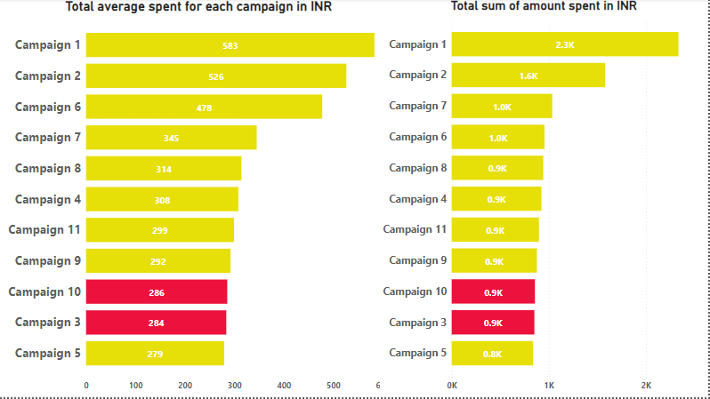
AVERAGE TOTAL SPENT ON EACH CAMPAING
Figure 1

Slide 5
Figure 1 indicates that in both graphs,Campaign 1 had the highest amount spent in INR. Followed by Campaign 2 and Campaign 6 which had the 3rd highest average amount spent. Here we compare the total average spent of each campaign in INR and the total sum spent on every campaign. This shows the among spent on each campaign and also the among spent on campaign 3 and 10

Slide 6
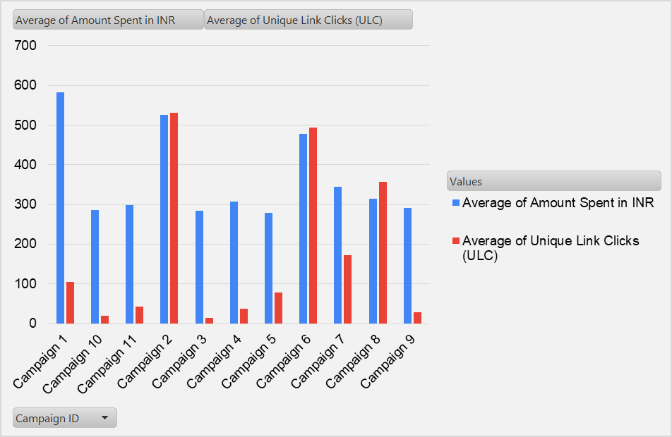
AVERAGE COST AND UNIQUE CLICKS
Figure 2

Slide 7
Figure 2 indicates the average cost of each campaign and the unique link clicks of each campaign as well, and this shows the cost in campaign and clicks in (10) and (3). The unique click in campaign (10) and (3) is smaller compare to others and there cost is higher.

Slide 8
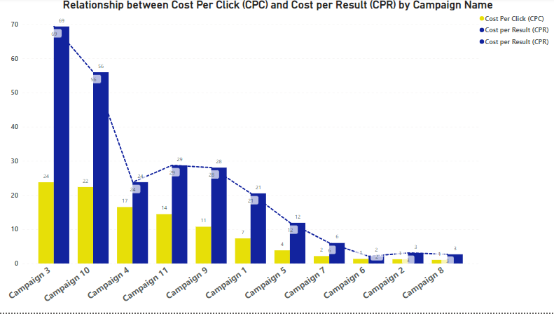
COST PER CLICK VS COST PER RESULT
Figure 3

Slide 9
Figure 3 indicates that campaign 3 had the highest Average of Cost per Result (CPR) and was ₹66.0 higher than campaign 8 which has the lowest Average of Cost per Click at ₹3.0. Across all 11 campaigns, Average of Cost per Click ranged from ₹24.0 to ₹4.0. Here campaign (3) and (10) had the highest cost per result and also the higest cost per clicks.

Slide 10
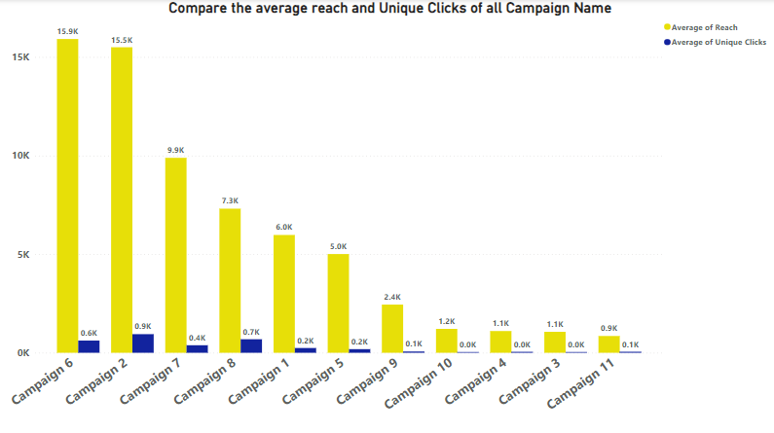
COMPARING COMPAIGN REACH AND UNIQUE CLICKS
Figure 4

Slide 11
Figure 4 indicates that campaign 2 had the highest Unique Link Clicks at 0.9k, and was 3525% higher than campaign 3, which had the lowest Average of Unique Link Clicks (UCL) at 0.0k. while campaign 6 had the highest reach at 15.9k compare to campaign 10 with 1.2k and campaign 3 had 1.1k respectively.

Slide 12
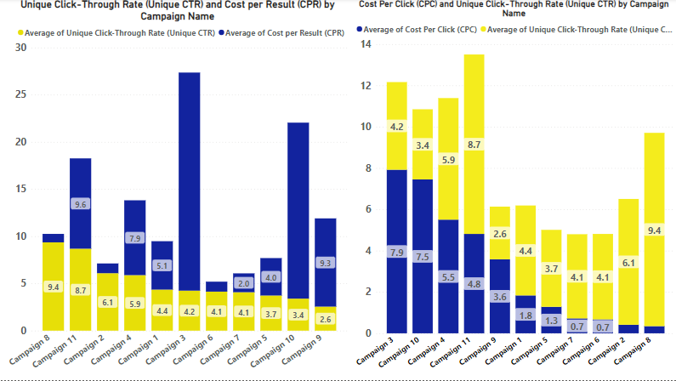
COST AND UNIQUE CLICKS THROUGH RATE
Figure 5

Slide 13
Fgure 5 indicates that campaign 3 had the highest cost per result and also had the highest cost per clicks followed by campaign 10, while campaign 8 had the highest unique click rate 9.4 with lowest cost while campaign 3 and 10 had a lower unique click rate of 4.2 and 3.4 respectively. On cost per click, campaign 3 had the highest cost followed by 10 while campaign 8 had the highest click through rate with lowest cost as well.

Slide 14
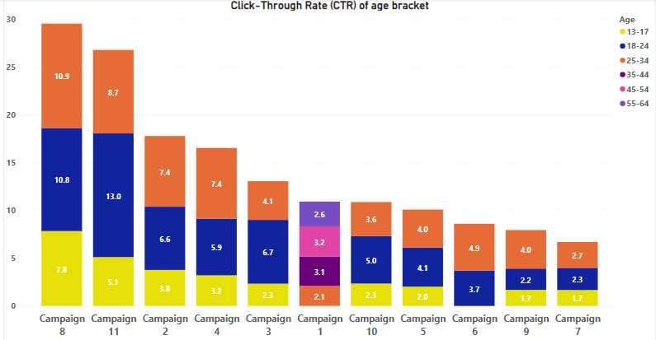
COMPARE BETWEEN CLICK RATE OF ALL AGE BRACKET
Figure 6

Slide 15
Figure 6 indicates that across all 11 campaigns, “Campaign 8” had the highest clicks from all age group followed by “Campaign 11” to the lest “Campaign 7”. This shows how all the age groups clicks on each campaigns.

Slide 16
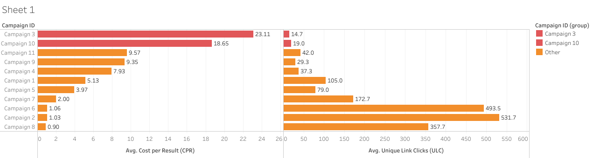
Average Cost per Result vs Unique Link Clicks
Figure 7

Slide 17
Figure 7 indicates that Campaigns 3 and 10 had the highest average cost per result along with the smallest average unique link clicks when compared with the other campaigns. A high cost per result means that the ad campaigns might not be meeting facebook ad requirements and did not get a lot of engagement from target audience. Campaigns 1 and 2 which had a higher total cost in INR had lower cost per result and higher unique link clicks than campaigns 3 and 10.

Slide 18
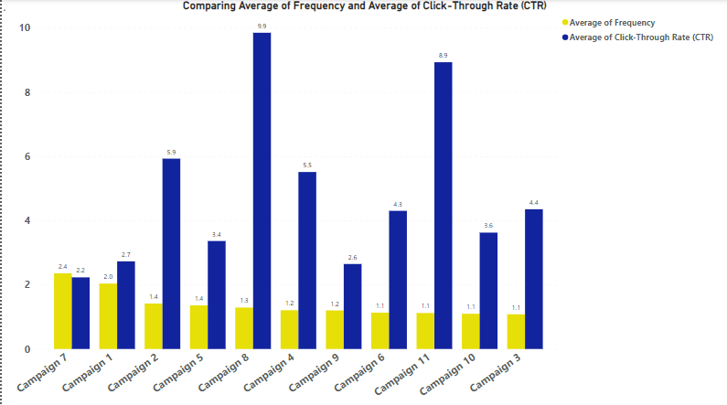
AVERAGE OF FREQENCY AND CLICKS THROUGH RATE
Figure 8

Slide 19
Figure 8 indicates that across all 11 campaigns, Average of clicks through rate ranged from 9.9 to 2.2, and average of frequency ranged from 2.4 to 1.1. The clicks through rate had the highest being campaign 8, and the least being campaign 7. The frequency had campaign 7 has the higher with 2.4, followed by campaign 1 which was 2.0, campaign 10 and 3 had the lowest frequency reach with 1.1 respectively.

Slide 20
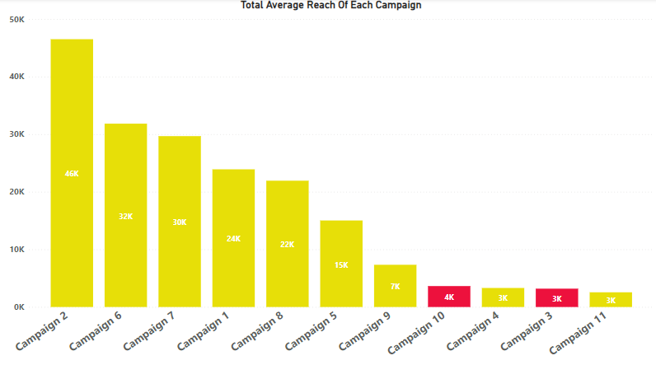
TOTAL AVERAGE REACH OF EACH CAMPAIGN
Figure 9

Slide 21
Figure 9 indicates that across all 11 campaigns, campaign 2 had the highest reach of 46k followed by campaign 6 with 32k and to the least campaign 11 with 3k reach. Campaign 10 had 4k reach while campaign 3 had 3k reach as well.

Slide 22
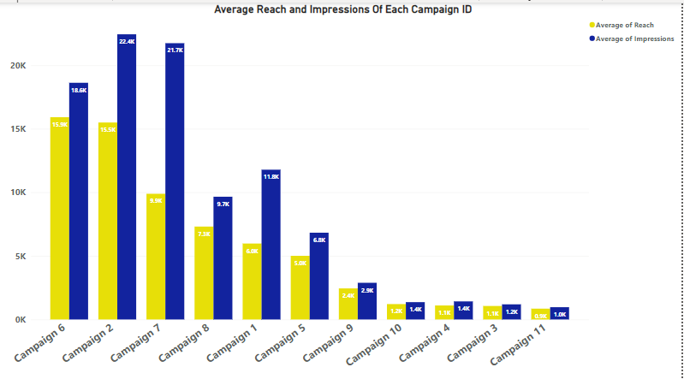
REACH AND IMPRESSION OF EACH CAMPAIGN
Figure 10

Slide 23
Figure 10 indicates that campaign 2 had the highest imperession followed by campaign 7 to the lest which is campaign 11. while campaign 6 had the highest campaign of reach followed by campaign 2 to the least which is campaign 11 as well. Campaign 10 and 3 had a bad impression and reach as well.

Slide 24
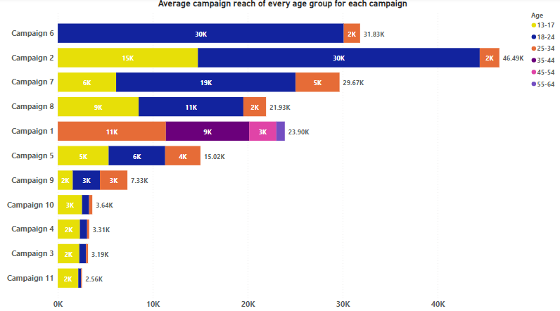
CAMPAIGN REACH OF ALL AGE GROUP
Figure 11

Slide 25
Figure 11 indicates that campaign 2 had the highest reach of all group age followed by campaign 6 and to the least which is campaign 11. Campaign 10 had 3.64k reach by all age group while campaign 3 had 3.19k reach.

Slide 26
MY RECOMMENDATION
My recommendation is that campaign (10) and (3) should be discontinue base on these reasons:
(1) Looking at the cost spend on both campaigns in (INR) and the result of their unique clicks shows that there cost is high compare to others and the result of there unique clicks is very low compare to others that there cost wasn’t up to these two campaign.
(2) Campaign (10) and (3) had the highest cost per click and cost per result but had a lowest result in campaign reach and unique clicks.
(3) While comparing cost (CPR)and (CPC) between unique click rate, campaign (10) and (3) had the highest cost with the lowest unique click.
●
●

Slide 27
(4) In age brackets not all the age bracket click on the campaign (10) and (3) while we see other campaigns that cost less and got a click from all the age brackets.
(5) In covering frequency and total click rate campaign (10) and (3) was low as well.
(6) While analysing the cost per clicks and cost per results of each campaign, campaign (10) and (3) had the highest cost per click and cost per result and generate low campaign results.
(7) They both have the lowest average reach and impressions among others.
(8) While analysis the campaign reach of every age group campaign (10) and (3)as well had a lower reach compare to others.
With all these reasons I recommend that campaign (10) and (3) should be discontinued.

